Slide 1
Designing for change
Creating an object by specifying a class explicitly

Slide 2
Creating an object by specifying a class explicitly
Commits you to a particular implementation instead of a particular interface
This commitment can complicate future changes
To avoid this, create objects indirectly

Slide 3
Design patterns
Abstract factory
Factory method
Prototype

Slide 4
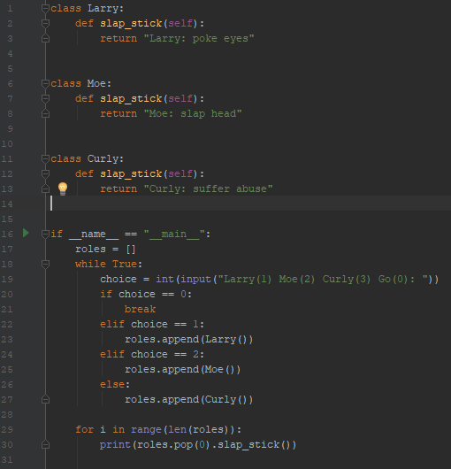
Example - Bad
Created object by explicitly calling the class

Slide 5
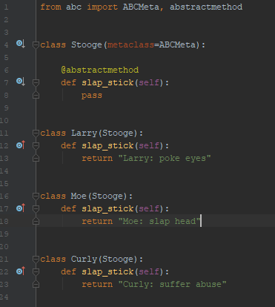
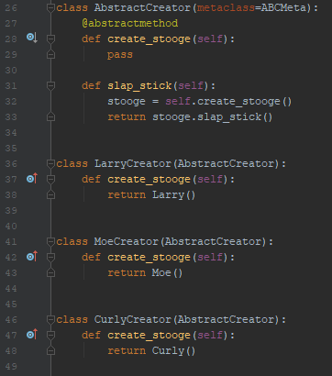
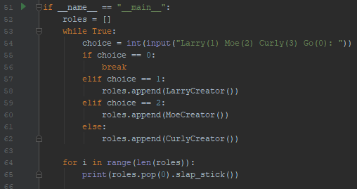
Example - Good
Object is indirectly created through the creator
Stooge and creator use interfaces
Open/closed principle
Notes:
Commits you to an interface, which adheres to the open/closed principle

